Slide 1

SYNC+3.0 SW Release Plan
Jiajia Zhou, Deyin Chen, Jiajian Wang, Zhijun Su, Kaijie Zhang
Date:11.13 2023
Desired Outcome
Awareness
Decision
Escalation Help
Think
Point of view
Plan to Implement
Implement

Slide 2
SYNC+3.0 Vehicles Timeline
2023 | 2024 | 2025
6 | 7 | 8 | 9 | 10 | 11 | 12 | 1 | 2 | 3 | 4 | 5 | 6 | 7 | 8 | 9 | 10 | 11 | 12 | 1 | 2 | 3 | 4 | 5 | 6
U611MCA
09/05
IPD: 11/21
TCF: 12/06
IPD: 1/02
TCF: 1/16
IPD: 04/2
TCF: 04/16
IPD: 07/02
TCF: 07/17
08/20
PEC
FEC
Pre-TT
TT
PP
MP1
MP2
OK
TB
8/11
IPD: 06/04
TCF: 06/19
9/21
10/19
U625 MCA
PEC
FEC
IPD: 11/21
TCF: 12/06
IPD: 1/02
TCF: 1/16
IPD: 04/2
TCF: 04/16
IPD: 07/02
TCF: 07/17
08/20
Pre-TT
TT
PP
MP1
MP2
OK
TB
U625 MY24
9/28
10/20
PEC
FEC
IPD: 06/04
TCF: 06/19
U718
11/30
HW:12/15
SW:01/24
IPD: 03/29
TCF: 04/08
IPD: 06/28
TCF: 07/15
11/18
TCF: 10/28
PEC
EPT2
FEC
TT
PP
MP1
MP2
OK
TB
IPD: 12/01
TCF: 12/11
IPD: 09/16
TCF: 09/30

Slide 3
SYNC+ 3.0 Vehicles Info
SYNC+ 3.0 Phase5 Scope
Program | PMO | IVI SW PM | Nameplate | Manufacture | J1 | OKTB | EE Architecture | Centerstack Size | Cluster |  | TCU | ECG
CDX707 | Li Daisy | Zhou Jiajia (XCL) | Nautilus | CAF | GAS: 2/1/2023 FHEV: 6/21/2023 | GAS: 3/28/2023 FHEV: 8/8/2023 | FNV3 | 23.6(Pano-Non touch)*2&11.1(Controller-Touch) |  | Landscape | Boundle6 | ECG2
U611 MCA | Chen Fengmin | Wang Jiajian | Aviator | CAF | 06/19/2024 | 08/20/2024 | FNV3 | 27 | 12.3 | Landscape | Boundle6 | ECG2
U625MCA | Chen Deyin | Su Zhijun | Explorer | CAF | 06/19/2024 | 08/20/2024 | FNV3 | 27 | 12.3，HUD | Landscape | Boundle6 | ECG2
U718 | Chen Fengmin | Zhang Kaijie | Navigator | BU | 09/30/2024 | 11/18/2024 | FNV3 | 23.6(Pano-Non touch)*2&11.1(Controller-Touch) |  | Landscape | Boundle6 | ECG2

Slide 4
U718 SW Release Plan @23/12/25
2023 | 2024
4 | 5 | 6 | 7 | 8 | 9 | 10 | 11 | 12 | 1 | 2 | 3 | 4 | 5 | 6 | 7 | 8 | 9 | 10 | 11 | 12
Project VPP
PEC
EPT2
FEC
TT
PP
MP1
MP2
OKTB
11/30
IPD : 12/1
TCF: 12/11
HW:12/15
SW:1/24
IPD: 3/29
TCF:4/8
IPD : 6/28
TCF : 7/15
IPD : 9/16
TCF : 9/30
11/18
TCF : 10/28
SW Release for FNA Team
Spring Festival
2.10-2.17
R00
07/8
R04
9/5
R05
11/06 Test Report
11/10 GNG
11/13 IVS
R05.1
1/15 Test Report
R05.2
3/4 Test Report
3/11 GNG
3/18 IVS
R06
5/24 Test Report
5/31 GNG
6/7 IVS
R07
8/9 Test Report
8/16 GNG
8/23 IVS
R07.1
9/11 Test Report
9/23 GNG
9/30 IVS
SW Release for REC
R00
6/26
R04
8/28
R05
10/18
R05.1
12/29
R05.2
2/19
R06
5/10
R07
7/26
R07.1
9/3
Vendor Integration
R00
5/23
R04
7/31
R05
9/18
R05.1
12/5
R05.2
1/15
R06
3/28
R07
6/27
R07.1
8/13
Carplay
Carplay (Disable)
Carplay (Enable)
Calibration
1st VR
11/28
2nd VR
2/29
ANC/ESE
10/23
Chime
11/20
BT
12/4
3rd VR
6/25

Slide 5
U718 SW Release Plan with Carplay@23/11/22
2023 | 2024
4 | 5 | 6 | 7 | 8 | 9 | 10 | 11 | 12 | 1 | 2 | 3 | 4 | 5 | 6 | 7 | 8 | 9 | 10 | 11 | 12
Project VPP
PEC
EPT2
FEC
TT
PP
MP1
MP2
OKTB
11/30
IPD : 12/1
TCF: 12/11
HW:12/15
SW:1/24
IPD: 3/29
TCF:4/8
IPD : 6/28
TCF : 7/15
IPD : 9/16
TCF : 9/30
11/18
TCF : 10/28
Vendor Integration
Spring Festival
2.10-2.17
R05
9/18
R05.1
12/5
R05.2
1/15
R06
3/28
R07
6/27
R07.1
8/13
Carplay Development Plan
Carplay Full Function Ready
(VSCS Disable)
03/08
Apple Approval
(C/O 707)
3/31
FO Sign-Off checkpoint
8/5
FO Sign-Off
Carplay
(VSCS Enable)
Dependency
3rd VR
TT Vehicle
06/05 – 08/05 TT VOCF with Carplay Weekly Version
(LWB+SWB, Susan’s team tester support, regularly update SW)
06/05 – 08/05 Supplier Tunning and FO Validation with Carplay Dedicate TT Vehicle
(LWB+SWB, Supplier and FO)

Slide 6
U611MCA SW Release Plan @ 23/11/14
2023 | 2024
5 | 6 | 7 | 8 | 9 | 10 | 11 | 12 | 1 | 2 | 3 | 4 | 5 | 6 | 7 | 8
U611MCA VPP proposal
IPD: 11/21
TCF: 12/06
IPD: 1/2
TCF: 1/16
IPD: 04/2
TCF: 04/16
IPD: 06/4
TCF: 06/19
IPD: 07/2
TCF: 07/17
08/20
PEC
FEC
Pre-TT
TT
PP
MP1
MP2
OK
TB
8/11
Spring Festival
IVS release
2.10~2.17
R05HF
12/05
IVS RELEASE
R06
3/1
IVS RELEASE
R07
5/16
IVS RELEASE
R07.1
7/12
IVS RELEASE
SW Release for CAF
R00
7/17
R04
8/25
R04.1
9/11
R05
11/19
R05 HF for EX2.5 Lib 12/01
R06
2/2 TEST DONE
GNG:2/23
R07
4/16 test done
GNG:5/7
R07.1
6/28 test done
GNG:7/05
MRD
SW Release for REC
R00
7/3
R04
8/14
R04.1
9/06
R05
10/23
R05
11/23
R06
1/12
R07
4/1
R07.1
06/24
Vendor Integration
R04.1 final eng
8/30 for redv
R00
5/30
R04
7/7
R04.1
8/15
R05
09/20
R05
11/17
R06
12/11
R07
3/1
R07.1
06/03
R07.1 only book for carplay
Notes:
有功能增加；
音频架构有变化。

Slide 7
U625 MY24 SW Release Plan @ 23/11/14
2023 | 2024
6 | 7 | 8 | 9 | 10 | 11 | 12 | 1 | 2 | 3 | 4 | 5 | 6 | 7 | 8 | 9
U625 MY24 VPP proposal
8/08
9/21
10/19
IPD: 11/21
TCF: 12/06
IPD: 1/02
TCF: 1/16
IPD: 4/02
TCF: 4/16
IPD: 6/04
TCF: 6/19
IPD: 7/02
TCF: 7//17
8/20
DCV
PEC
FEC
Pre TT
TT
PP
MP1
MP2
OK
TB
OTA
IVS release
Spring Festival
2.10~2.17
R05 HF
12/05
IVS RELEASE
R06
3/01 IVS release
R07
5/16 IVS release
R07.1
7/12 IVS release
SW Release for CAF
R00
7/26
R04
9/15
ANC vbf check
R04.1
10/08
R05
11/19
R05 HF for EX2.5 Lib 12/01
R06
2/08 TEST DONE
GNG: 2/23
R07
4/24 TEST DONE
GNG: 5/07
R07.1
6/28 TEST DONE
GNG 7/05
MRD
SW Release for REC
R00
7/12
R04
8/21
R04.1
9/15
R05
11/06
R05
11/23
R06
1/19
R07
4/08
R07.1
6/24
Vendor Integration
R04.1
8/30
R05
11/17
R06
12/18
R07
3/08
R07.1 only for carplay
R00
6/08
R04
7/21
R05
10/12
R07.1
6/03
Notes:
有功能增加；
音频架构有变化。

Slide 8
U625 MY24 & U611MCAJ1 with CarPlay Plan
9 | 10 | 12 | 1 | 2 | 3 | 4 | 5 | 6 | 7 | 8 | 9 | 10
IPD: 11/21
12/26
TCF: 12/06
01/16
IPD: 02/20 03/26
TCF: 03/06 04/16
IPD: 04/30
06/04
TCF: 05/15 06/19
IPD: 05/29 07/02
TCF: 06/12 07/17
07/05
08/20
U625 MY24 &U611MCA Build Plan
TT
PP
MP1
MP2
OK
TB
OTA
TBD
The CarPlay VSCS is open from PP MP2 build
Besides VSCS, the CarPlay should also have compile option to enable/disable
New Year
Holiday
Spring Festival
Tomb
Sweeping
IVI Integration Plan
R06
R06
R07
R07
R07.1
R07.1
R08
R08
12/11 INT
U611
12/18 INT
U625
03/01 INT
U611
03/08 INT
U625
06/03 INT
U611
Carplay Ckp
06/03
INT
U625
TBD
TBD
CarPlay Development Plan
09/06
Full Function
12/29
1st FO signoff(checkpoint)
05/232nd FO signoff
04/15
Apple
Approval
Dependency
1st VR
Vehicles
U611/U625
U611: 02/05 – 03/01 Supplier Tunning
02/19 – 5/24 CarPlay VOCF with Weekly SW(low+mid+high, Susan’s team tester support, regularly update SW)
U625: 01/18 – 02/02 Supplier Tunning
02/19 – 05/31 CarPlay VOCF with Weekly SW(low+mid+high，Susan’s team tester support, regularly update SW)
TBC ITEMS:
Susan function test with Carplay.--Susan
Feature mini DV with Carplay.--Sylvia
Carplay readiness review standard or criteria . –Dekang/Emma
Carplay related issue filter, label mark/affect version.
Notes:
Dekang: R07 集成CarPlay，需要delay 到3.15集成 –- 不用
Jiajia: IVI SW integration & release workflow -- done
Emma: R06.1 for CarPlay signoff bug fix –- 不需要R06.1， 所有carplay 改动，按照IVI 正常的软件集成做即可
Emma: VR is the pre-condition of CarPlay -- done
Jiajia: PP FCPA/NTT -- done
Dekang: TT VOCF/FCPA/NTT long mileage – Done
TT 不用delay
Plan special SW to support PP VOCF
MP1 打开 CarPlay
MP2 要么disable carplay，要么出版本fix issue
02/19 – 06/01(U611/U625，可分段，需要和VOCF 对齐跑车计划
期间跑两个版本，每个版本两周)
元旦：12/30 – 01/01
春节：02/10 – 02/17
清明：04/04 – 04/06
劳动节： 05/01 – 05/05
端午节： 06/08 – 06/10

Slide 9
Enablers
Enablers | Date | Comments | Status | DRI
Vehicle | 2024/01/18 - 2024/03/01 | No U611 14 speakers & U625 10 speakers to support CarPlay Cerence tunning |  | U611: Xu Emma U625: Pan Nancy
VSCS | 2024/01/16 - 2024/07/17 | The CarPlay which is disabled as default and can only be enabled before testing The CarPlay will be enabled as default in MP2 build |  | Qi Ronggui
Additional TT VOCF/PP VOCF/NTT | 2024/02/19 - 2024/05/31 | Lite Case provide Three dedicated vehicles to cover all series for U611/U625 Need to align with VOCF team about the plan |  | VOCF
Apple Certification | 2024/04/15 | Ensure pass the Apple Certification |  | Geng Dekang
Test Cases | 2024/01/05 | The test cases should be ready before 2024/01/05 to support TT VOCF & NTT/PP VOCF & NTT |  | Geng Dekang
Notes:
VOCF//NTT: 每个配置一台车
VOCF 专项测试，由REC/Supplier 派人跟车
VOCF 长里程，提供测试用例
NTT 测试用例由谁提供？？？？？？？？？？
UAT team to be involved？？？？？？？？？？？？？？
TT VOCF/FCPA/NTT
VR

Slide 10
Enablers - Vehicles
Model | Build Type & Number | Series | ATS | Duration Of Use | Status
U611 | Pre-TT_09 | 104A 28 speakers | 6th/Jan | 5th/Feb – 1st/Mar
U611 | Pre-TT_10 | 101A 9 speakers | 12th/Jan
U611 | TBD | 102A 14 speakers | TBD | 5th/Feb – 1st/Mar
U625 | Pre-TT_15 | ST-Line 14 speakers | 8th/Jan | 18th/Jan – 2nd/Feb
U625 | Pre-TT_16 | Trend 6 speakers | 4th/Jan
U625 | TBD | Titanium 12 speakers | TBD | 18th/Jan – 2nd/Feb
Notes:
VOCF//NTT: 每个配置一台车
VOCF 专项测试，由REC/Supplier 派人跟车
VOCF 长里程，提供测试用例
NTT 测试用例由谁提供？？？？？？？？？？
UAT team to be involved？？？？？？？？？？？？？？
TT VOCF/FCPA/NTT
VR

Slide 11
Backup material

Slide 12
Phase5 SYNC+ 3.0 Timeline Draft To Be Reviewed
1 | 2 | 3 | 4 | 5 | 6 | 7 | 8 | 9 | 10 | 11 | 12 | 1 | 2 | 3 | 4 | 5 | 6 | 7 | 8 | 9 | 10 | 11 | 12 | 1 | 2 | 3 | 4 | 5 | 6 | 7 | 8 | 9 | 10 | 11 | 12
Key Checkpoint
1. Supplier Sourced (SOBD)
======
1.Bill of feature(MFL) Finalized
2.Platform feature spec complete and cascaded
3.Function Safety Concept updated and completed
4.Cybersecurity Requirements Identified
5.UX(UEUI) alignment confirmed
6.SW environment and baseline Design
7.pre-2EC
1.DCV Beta verified supporting Pre-DV/EMC, critical function including Climate/Camera/Radio/Music/Video/Navigation/Speed meter/Driving Info etc.
2.Feature Software early system-level integration test start at <FDJ> breadboard
3. UX doc sign off by HMI/Studio team
1All design verification testing completed by <PEC>
2.Feature Software system-level integration test complete and sign off by feature owner and HMI team
3.R00 release for <PEC> without critical blocker issue,
4.Diagnostics Part2 DV(iTV) test report shows 100% passed
1.Bill of feature Initialized(MFL)
2.Feature Owner confirmation
3. Basic Level spec are available
4.1EC
1. Platform feature spec finalization and sign off
2.Simulate feature integration of interfaces, states and responses to requested behavior
3. Early test of new and C/O features with physical parts
4.2EC
1. Software OTA window preserved post Job1 and before OKTB.
1.DCV1 verified supporting DV/EMC/DCV MRD with full function code completed.
2.Feature Software early system-level integration test complete by <DCV> breadboard, verify feature functionality and performance requirements.
1. Agile feature full function Integration without critical bug.
Project VPP
UPV2
10W
26W
DCV
13W
UPV1
14W
PA
FDJ
PEC
FEC
TT
PP
MP1
MP2
PS/PSC
14W
UPV0
OKTB
UX Release
6 weeks
Group A UI
For Pre DV/FDJ
Group B UI
For Critical DV/DCV
Group C UI
For DCV
Group D UI
For DCV/PEC
DCV Critical Path * 45 weeks
>=14 weeks
>=32 weeks
Group A Features Coding based on UI
DCV Alpha
DCV Beta
test
Eng Version
DCV0
test
A1
Pre DV
Hardware
Debug
B0
Critical DV
A0 PCBA
A1 Sample
B0 Sample
B1 Sample
17 weeks(4 months)
4 weeks
5 weeks
>=6 weeks
9 weeks
9 weeks
9 weeks
>=6 weeks
GPDS SW Version for MRD
5 weeks
DCV
DCV Beta
DCV0
DCV1
DCV MRD
R00
R05
R06
R07
R04
R08
Display light up
Platform Arch design
PIPELINE Design
Features and HMI Design
Initial release for Pre DV
DCV Beta
30% Coding
Release Fundamental features for DCV vehicle testing
DCV1
60% Coding
Zero IG defects supporting PEC sign off
R00
95% Coding(Not including Agile features)
Delivery of all features with zero G issues
R05 100% Coding
AIMS Issue solve / Bug fix
R06 100% Coding
AIMS Issue solve / Bug fix
R07 100% Coding
Hotfix for OKTB
10weeks(2.5months)
8weeks(2months)
17 weeks(4months)
17 weeks(4months)
13 weeks(3months)
8weeks(2months)
9 weeks(2months)
Preserved

Slide 13
SYNC+ 3.0 DCV/PEC/J1 Critical Path
China Accelerated SW Plan ---DCV Critical Path
45 weeks
Group A UI Release
DCV Beta 30%
DCV0 50%
DCV1 60%
FDJ
DCV
Group A Features Coding based on UI
DCV Alpha
DCV Beta
Test
A Sample
Pre DV
Debug
B Sample
Critical DV
MRD
Display light up
Platform Arch design
PIPELINE Design
Features and HMI Design
Initial release for Pre DV
DCV Beta
30% Coding
Release Fundamental features for DCV vehicle testing
DCV1
60% Coding
10weeks(2.5months)
8weeks(2months)
17 weeks(4months)
China Accelerated SW Plan ---PEC/J1 Critical Path
4 weeks
5 weeks
6 weeks
6 weeks
9 weeks
9 weeks
9 weeks
DCV
DCV
PEC
FEC
TT
PP
J1
OKTB
DCV1 60%
DCV MRD
R00
95%
R04
R05
100%
R06
R07
R08
Zero IG defects supporting PEC sign off
R00 (4*SW iterated versions )
95% Coding(Not including Agile features)
Delivery of all features with zero G issues
R05 100% Coding for TT MRD
AIMS Issue solve / Bug fix
R06 100% Coding for PP MRD
AIMS Issue solve / Bug fix
R07 100% Coding for J1
Hotfix for OKTB
R08 100% Coding
17 weeks(4months)
13 weeks(3months)
8weeks(2months)
8 weeks(2months)
Preserved

Slide 14













What’s SYNC+ PDL & FIP
Tech
Planning
Marketing
HMI Design
(UE & UI)
ECDX
IVI SW PDL
Forum
Customer Facing
Features
(ECDX PMO maintain)
Manager
Review
B
C
A
D
Basic(ECU) Functions
(EESE IVI SW maintain)
IVI SW PDL
(ECDX PMO maintain)
Feature
Delivery
Leader
A
Supplier Workload Ratio
IVI SW FIP
(EESE IVI SW
maintain)
Feature
Owner
ECU Functional SPEC Information
EESE IVI
SW & SYS
Feature
Cascade
BOF Cascade Features
(FDL maintain)
Feature Integrate Schedule
A
B
(EESE IVI SW maintain)

Slide 15
GPDS Delivery Health Chart VS U6XX Actual Delivery Status.
GPDS MCA Platform Timing
PSC
14w
UPV0
13w
UPV1
14w
UPV2
10w
FDJ
26w
DCV
33w
26w
Program Content/BOF cascade did not follow the GPDS3.3 Process.
HMI delivery plan did not follow the Global/Go Fast Health Chart.
How to guarantee SW maturity meet the Global Software Maturity Progression? ---Deviation needed.
GPDS Feature and SW Pocket Card
20w
3w-4w
BOF Finalized
Feature List Aligned to PDL
SOBA
Group A UI
(K4+4W)
Group B UI
(K5+4W)
Group C UI
(K6+4W)
Group D UI(FAA+4W)
Group E Animation (FAA-4W)
HMI Health Chart Created
Feature/Function Spec Complete
DCV Beta For FDJ BB
DCV1 For DCV MRD
45w
Group A UI latest date
China SYNC+ 3.0 Critical Path: New/Modified IVI Platform & New UE/UI
U6XX MCA Actual Story
PSC
UPV0
UPV1
UPV2
FDJ
DCV
DCV
01/11
03/30
06/25
10/25
12/7
DCV EBB MRD
04/01
DCV YB MRD
05/13
06/13
Proposed 08/16
2021/05
Confirmed U6XX in Phase5 Scope
BOF Cascade started to involve China Team
11/09
Group A UI
04/17
DCV Beta For FDJ BB
07/15
DCV1 For DCV MRD
2021/07/20
HMI KOTEI SOBA
2021/09/01
SYNC+ PDL Initialized Version released with continuously change
2021/0908 RFQ released to Package1/2/3
39w(6w has been compressed)
China SYNC+ 3.0 Critical Path: New/Modified IVI Platform & New UE/UI
SW Develop Team Compressed the initial over 4months delay to 2 months by OT work
Notes:
有功能增加；
音频架构有变化。

Slide 16
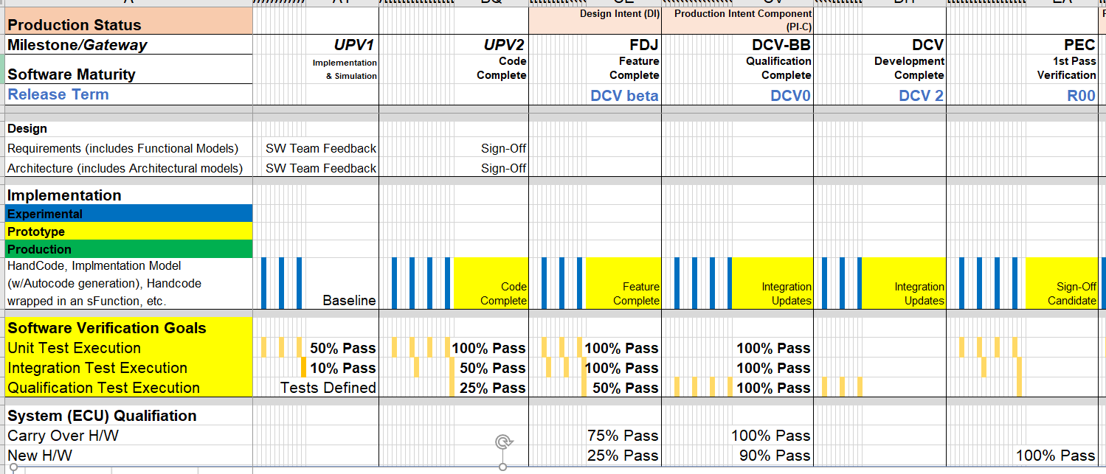
Software Maturity Progression Request

Slide 17
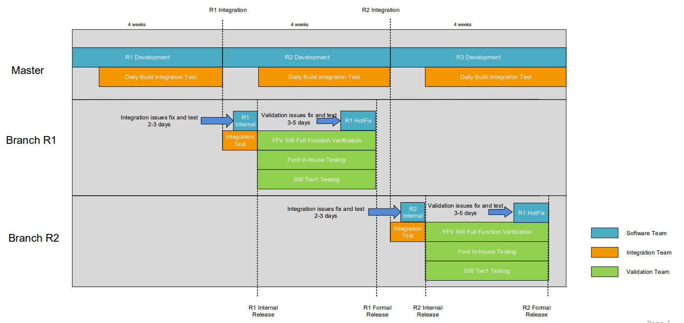
SYNC+3.0 SW Integration and Release Rule
2021 | 2022 | 2023
Checkpoint2:
Eng SW Release for REC
Checkpoint1:
Vendor Integration
Checkpoint3:
Pro SW Release for CAF/FO
Checkpoint4:
R1, R2 Must fix issue List Release

Slide 18
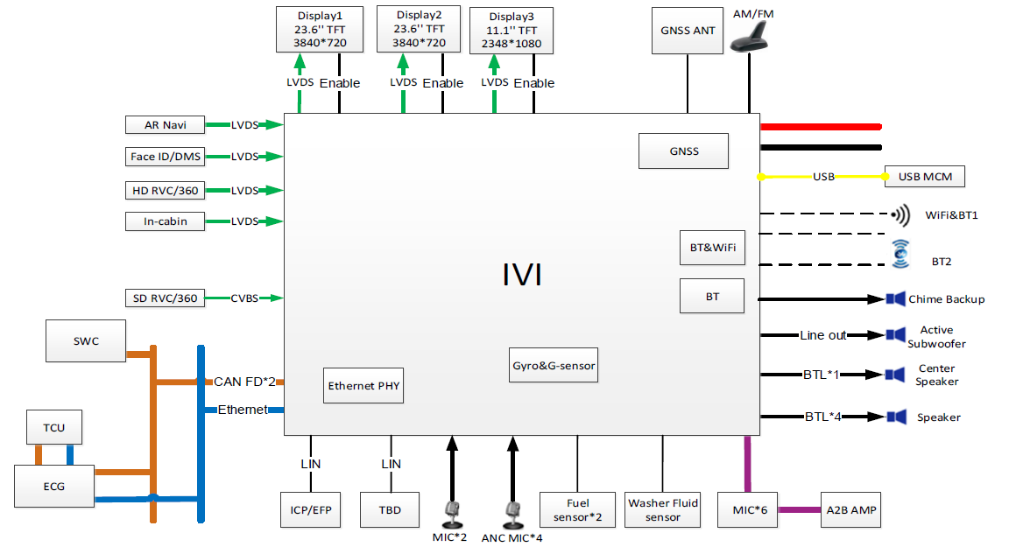
CDX707 System Block Diagram
2021 | 2022 | 2023

Slide 19
CDX707 DCR Control Process Proposal
2021 | 2022 | 2023
3 | 4 | 5 | 6 | 7 | 8 | 9 | 10 | 11 | 12 | 1 | 2 | 3 | 4 | 5 | 6 | 7 | 8 | 9 | 10 | 11 | 12 | 1 | 2 | 3 | 4 | 5 | 6 | 7 | 8 | 9 | 10 | 11 | 12
CDX707
UPV1
UPV2
PA
FDJ
DCV
GAS
PEC
FEC
TT
PP
MP1
MP2
OKTB
07/30
08/18
09/10
02/02
01/28
07/19
09/07
11/23
02/01
03/01
03/28
03/05
08/29
Audio(24 Channel Amplifier): 05/E Amplifier ready,06/10 retrofit with the latest SW.
FHEV
FDJ
DCV
HB
PEC
FEC
TT
PP
MP1
MP2
OKTB
05/11
08/31 Retrofit
09/30
12/07
01/03
02/01
04/19
06/21
07/19
08/08
阶段1[->DCV3]：主体功能交付完毕，不允许大的架构性变化
阶段2[DCV4->R06]：体验优化，接受部分Agile feature 合入（影响系统性能的，务必于R00之前完成支持PEC sign off）其他due date为R05.
阶段3[R07->R08]：AIMS issue bug fix, 非必要不进行任何新功能合入.
SW Release for REC. CAF/FO
CP1
CP2
CP3
CP4
DCV2
01/12
01/26
DCV3
02/16
03/02
DCV4
03/23
04/06
R00
05/18
06/01
R04
06/15
06/29
R05
07/13
07/25
R07
11/20
12/04
R08 for OKTB
01/15
01/24
DCV0
10/20
11/03
DCV1
12/15
12/29
DCV5
04/20
05/04
R06
09/07
09/21
Patch1:Carry over HQX1.0 Feature base on HQX1.2.1 Engineering line
FC(Feature Complete): Initial Release
Patch2:Fix Critical Issue support CDX707 FEC
CS(Commercial Sample):
Support new feature/Performance/stability improvements/Boot KPIs (100%)/CTS/VTS/STS - Coverage (100%)
Post CS/ZBB: Bug Fixes, Security Fixes

Slide 20
SYNC+3.0 Vehicles Timeline
2021 | 2022 | 2023 | 2024
3 | 4 | 5 | 6 | 7 | 8 | 9 | 10 | 11 | 12 | 1 | 2 | 3 | 4 | 5 | 6 | 7 | 8 | 9 | 10 | 11 | 12 | 1 | 2 | 3 | 4 | 5 | 6 | 7 | 8 | 9 | 10 | 11 | 12 | 1 | 2 | 3 | 4 | 5 | 6 | 7
CDX707
UPV1
UPV2
PA
FDJ
DCV
GAS
PEC
FEC
TT
VOCF
PP
MP1
MP2
OKTB
1st OTA
2nd OTA
07/30
08/18
09/10
02/02
01/28
07/19
08/29
09/26
11/03
12/06
02/07
02/28
03/07
03/28
04/04
04/25
05/15
06/23 FCS
TBD
03/05
FHEV
FDJ
HB
DCV
PEC
FEC
TT
PP
MP1
MP2
OKTB
05/11
07/01
09/30
08/31
10/17
Retrofit
02/01
02/15
04/19
06/21
07/19
08/08
12/07
01/03
U611 MCA
PEC
UPV0
UPV1
UPV2
PA
FDJ
DCV
HB
FEC
Pre TT
TT
PP
MP1
MP2
8/11
06/19
03/30
06/25
10/25
1/12
2/21
2/8
02/28
9/5
12/06
01/16
04/16
07/17
OKTB
U625MCA
FEC
UPV0
UPV1
UPV2
FDJ
DCV
HB
PEC
08/20
03/30
10/19
6/25
10/25
12/7
2/8
02/28
9/21
U625 MY24
PA
FDJ
DCV
PEC
FEC
Pre TT
TT
PP
MP1
MP2
5/12
5/26
8/8
9/28
10/19
12/06
01/16
04/16
06/19
07/17
OKTB
U718
08/20
UPV0
UPV1
UPV2
PA
FDJ
DCV
PEC/FEC
EPT2
TT
PP
MP1
MP2
OK2B
12/17
06/21
10/13
11/13
2/12
5/6
8/19
9/23
08/10
8/3
3/20
11/8
7/22

